Slide 1

COMS W4111 - Introduction to Databases
DBMS Architecture and Implementation: Query Processing, Transactions, Recovery
Donald F. Ferguson (dff@cs.columbia.edu)
Lecture 11a: Query Processing, Query Optimization

Slide 2

Module II – DBMS Architecture and Implementation
2 | Introduction to Databases (S20) – Lecture 11a: Query Processing, Query Optimization

Slide 3

Data Management
Find things quickly.
Control access.
Durability
Process queries quickly/cheaply
Database Systems: The Complete Book (2nd Edition) by Hector Garcia-Molina (Author), Jeffrey D. Ullman (Author), Jennifer Widom (Author)

Slide 4
Query Processing
4 | Introduction to Databases (F18): Lecture 10 Query Processing. Transactions, Recovery

Slide 5

Overview
5 | Introduction to Databases (F18): Lecture 10 Query Processing. Transactions, Recovery

Slide 6
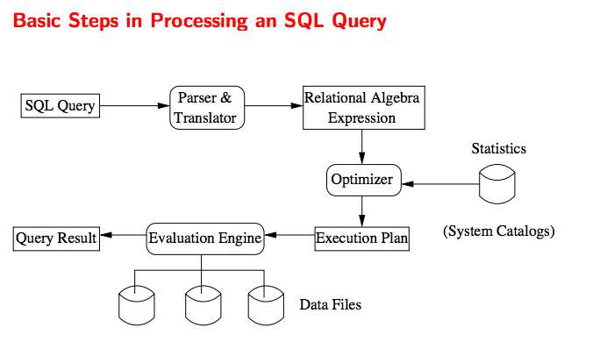
Query Processing Overview

Slide 7
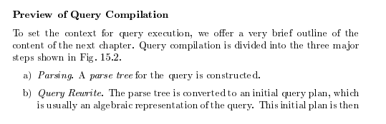
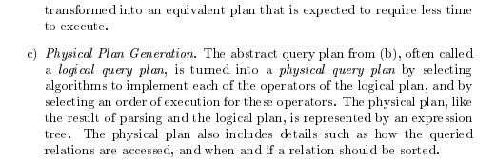
Query Compilation
Database Systems: The Complete Book (2nd Edition) 2nd Edition
by Hector Garcia-Molina (Author), Jeffrey D. Ullman (Author), Jennifer Widom (Author)

Slide 8
Parsing and Execution
Parser/Translator
Verifies syntax correctness and generates a parse tree.
Converts to logical plan tree that defines how to execute the query.
Tree nodes are operator(tables, parameters)
Edges are the flow of data “up the tree” from node to node.
Optimizer
Modifies the logical plan to define an improved execution.
Query rewrite/transformation.
Determines how to choose among multiple implementations of operators.
Engine
Executes the plan
May modify the plan to optimize execution, e.g. using indexes.

Slide 9
Parsing
9 | Introduction to Databases (F18): Lecture 10 Query Processing. Transactions, Recovery

Slide 10
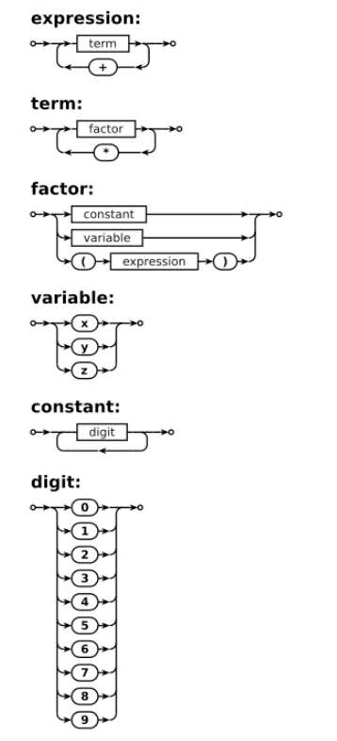
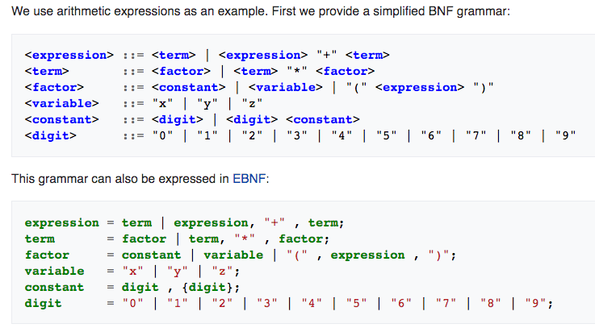
Grammar/Syntax Diagrams

Slide 11
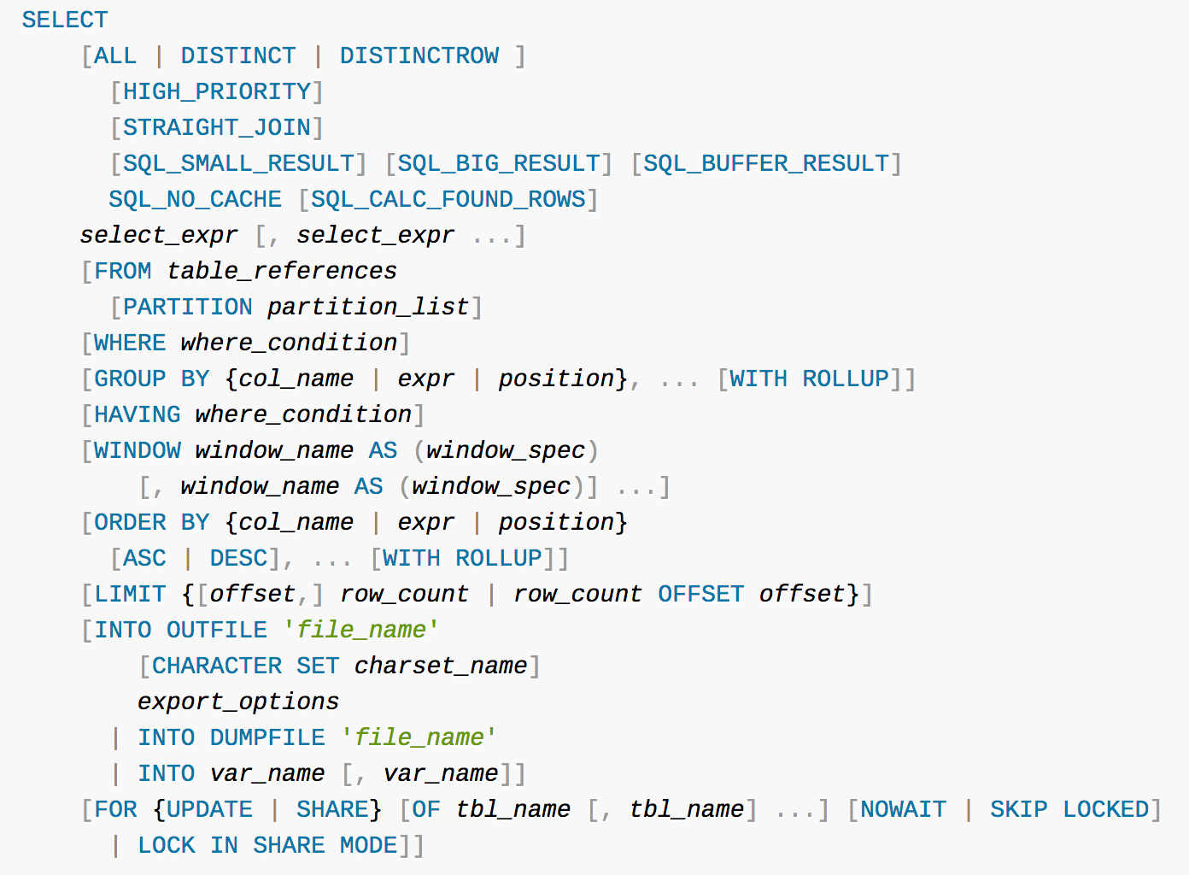
Parser
Grammar rules define valid SQL statements.
Query parser
Validates syntax.
Produces a logical parse tree/plan.
The optimizer and execution engine execute the plan.
Similar to any programming language

Slide 12
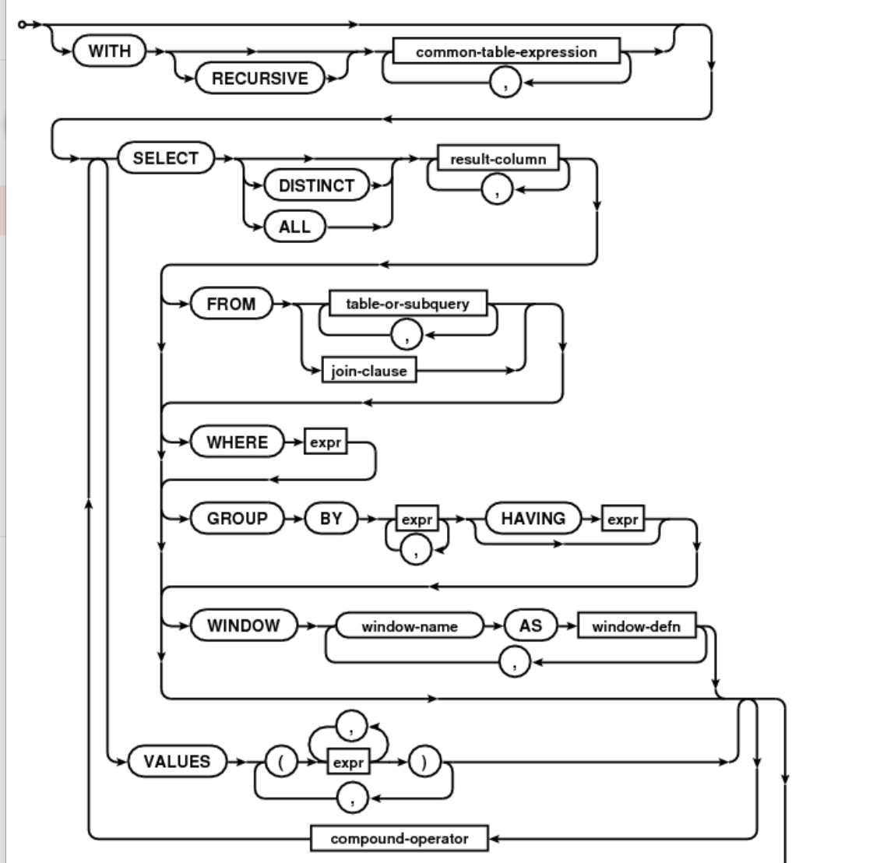
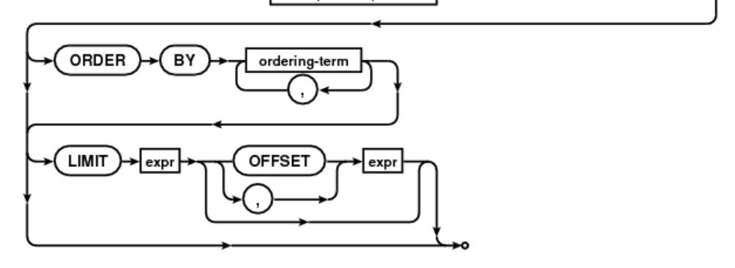
Parser
Formal definition of the SQL Language
Grammar rules.
Parse diagrams/machines.
You will learn about these concepts if you take:
COMS W3261: Computer Science Theory.
COMS W4115: Programming Languages and Translators.
Parser/Translator:
Validates the syntax is correct.
Validates that the symbols are correct, e.g. the table exists.
Converts the statement into an intermediate form that can be compiled or interpreted, just like any other computer language.

Slide 13
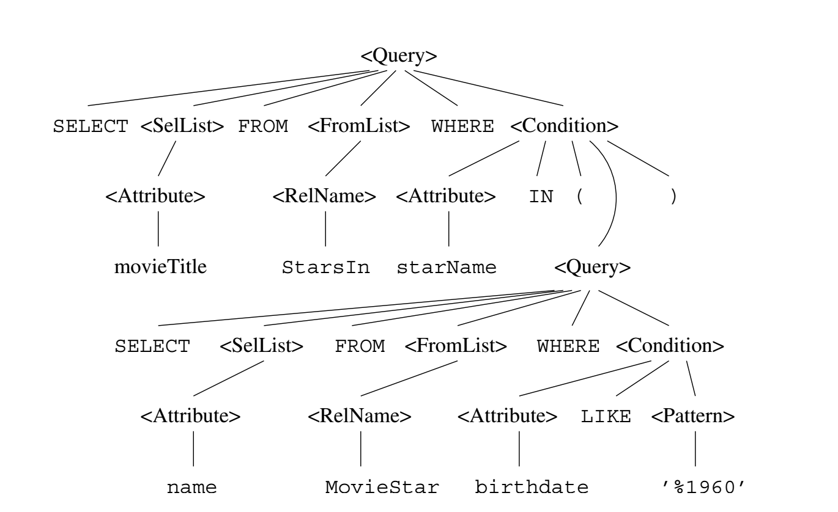
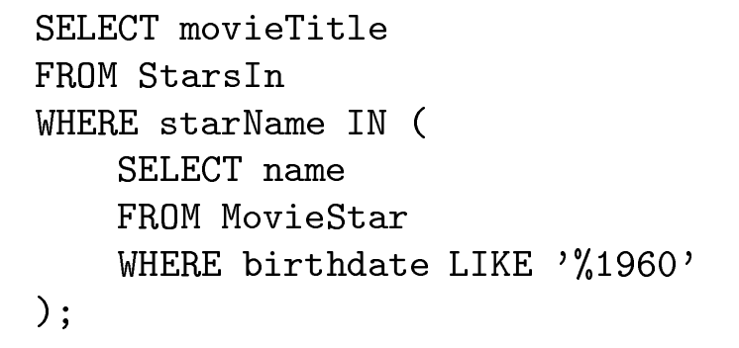
SQL Parse Tree

Slide 14
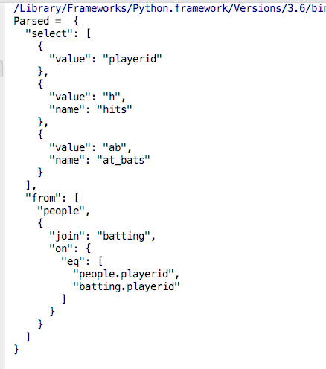
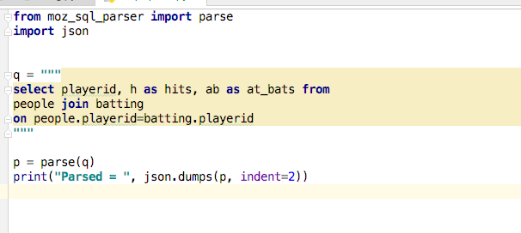
Simple Parsing Example
https://github.com/mozilla/moz-sql-parser
Lecture: Skim code at https://github.com/mozilla/moz-sql-parser

Slide 15
Python While Loop Syntax Tree

Slide 16
Query Plan/Logical Plan
16 | Introduction to Databases (F18): Lecture 10 Query Processing. Transactions, Recovery

Slide 17
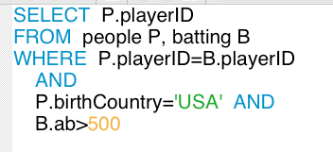
Simple Execution/Plan Tree
playerID
𝞂
ab> 500
birthCountry=‘USA’
The nodes are SQL operators. The operator parameters are:
Relations.
Parameters to operators.
The edges are the flow of data. The data flowing is a relation.
Base table.
Derived table.
playerID=playerID
people
batting

Slide 18
Relational Operations
We will consider how to implement:
Selection ( ) Selects a subset of rows from relation.
Projection ( ) Deletes unwanted columns from relation.
Join ( ) Allows us to combine two relations.
Set-difference ( ) Tuples in reln. 1, but not in reln. 2.
Union ( ) Tuples in reln. 1 and in reln. 2.
Aggregation (SUM, MIN, etc.) and GROUP BY
Since each op returns a relation, ops can be composed! After we cover the operations, we will discuss how to optimize queries formed by composing them.
Notes:
3

Slide 19
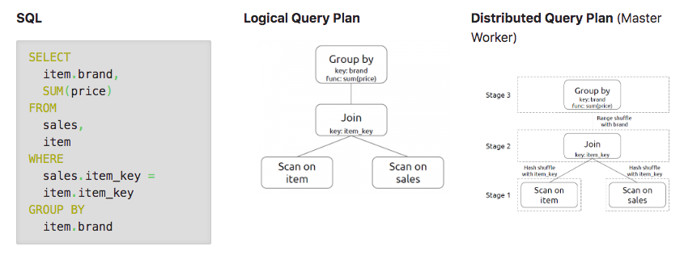
Logical Plan
https://gerardnico.com/data/type/relation/engine/query_plan
The plan executes in stages (bottom up).
Some stages can have parallelism, e.g. multiple threads to improve CPU utilization while processing I/O.
Notes:
Scan: one way to do a SELECT
Can be done in parallel (on different computers/cores)
Can flow to another computer that does the JOIN

Slide 20
Optimization/Execution Overview
20 | Introduction to Databases (F18): Lecture 10 Query Processing. Transactions, Recovery

Slide 21
Overview of Query Evaluation
Plan: Tree of R.A. ops, with choice of alg for each op.
Each operator typically implemented using a `pull’ interface: when an operator is `pulled’ for the next output tuples, it `pulls’ on its inputs and computes them.
Two main issues in query optimization:
For a given query, what plans are considered?
Algorithm to search plan space for cheapest (estimated) plan.
How is the cost of a plan estimated?
Ideally: Want to find best plan. Practically: Avoid worst plans!
Notes:
2
Generates all trees equivalent to the query

Slide 22
Query Compilation
Database Systems: The Complete Book (2nd Edition) 2nd Edition
by Hector Garcia-Molina (Author), Jeffrey D. Ullman (Author), Jennifer Widom (Author)

Slide 23
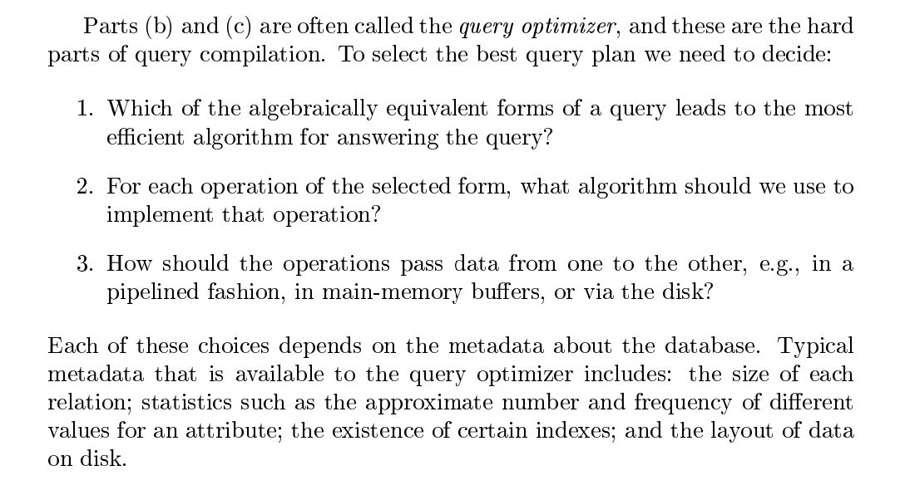
Query Optimization

Slide 24
Three Core Optimization Techniques
Query rewrite: Transform the logical query into an equivalent, more efficient query (lower cost query), e.g.
R ⋈ S is the same as S ⋈ R
𝞼(R ⋈ S) (order R*S) is the same at 𝞼(R) ⋈ 𝞼(S) (order max(R, S))
𝛅(R ⋈ S) = 𝛅(R) ⋈ 𝛅(S), where 𝛅 is the distinct operator.
Access path selection: How to run SELECT on a table? Which index to choose?
Operator implementation selection:
There are several related implementations for each operator
For example,
Sort Scan
Sort Join
Hash Join
Hash Distinct

Slide 25
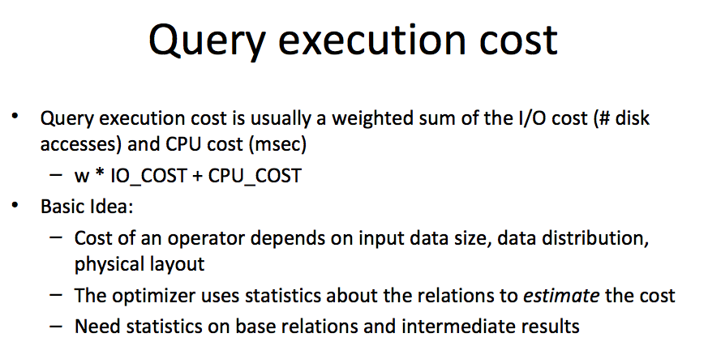
Query Execution Cost
Notes:
Note: IO cost is dominant (~80%)

Slide 26
Statistics and Catalogs
Need information about the relations and indexes involved. Catalogs typically contain at least:
# tuples (NTuples) and # pages (NPages) for each relation.
# distinct key values (NKeys) and NPages for each index.
Index height, low/high key values (Low/High) for each tree index.
Catalogs updated periodically.
Updating whenever data changes is too expensive; lots of approximation anyway, so slight inconsistency ok.
More detailed information (e.g., histograms of the values in some field) are sometimes stored.
Notes:
8

Slide 27
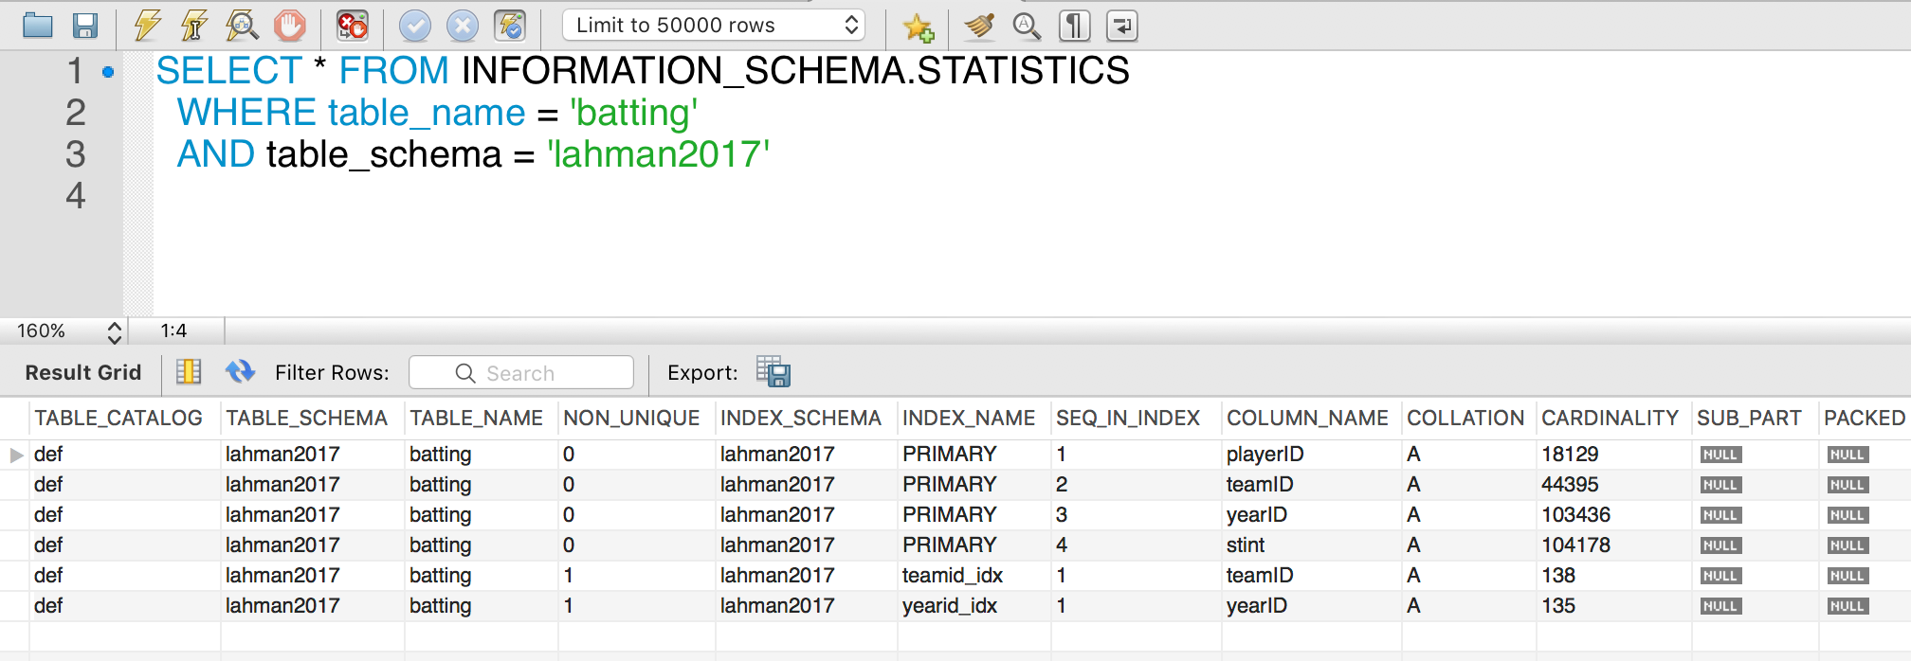
MySQL Example

Slide 28
The Catalog Contains
For each table
Table name, storage information.
Attribute name and type for each column.
Index name, type and indexed attributes
Constraints
Statistical information
Cardinality of each table
Size: No. of blocks.
Index cardinality: Number of distinct key values for each index
Index size: Number of blocks for each index.
Index tree height
Index ranges

Slide 29
Access Path
Every relational operator accepts one or more tables as input. The operators “accesses the tuples” in the tables.
There are two “ways” to retrieve the tuples
Scan the relation (via blocks)
Use an index and matching condition.
A selection condition is in conjuctive normal form if
Each term is column_name op value
op is one of <, <=, =, >, >=, <>
The terms are combined, e.g. (nameLast = ‘Ferguson’) AND (ab > 500)
CNF allows using a matching index for the access path.
The engine can select a matching index
A Hash Index on (c1,c2,c3) if the condition is c1=x AND c2=y AND c3=z.
A Tree Index if the condition is (can be ordered as)
c1 op value
c1 op x AND/OR c2 op y
… …
Many indexes may match, and the engine chooses the most selective match (number of tuples or blocks) that match.
Notes:
Most selective index = one with the most entries
Indexed entries: only have to read height of tree
Otherwise, need to read all blocks

Slide 30
Access Paths
An access path is a method of retrieving tuples:
File scan, or index that matches a selection (in the query)
A tree index matches (a conjunction of) terms that involve only attributes in a prefix of the search key.
E.g., Tree index on <a, b, c> matches the selection a=5 AND b=3, and a=5 AND b>6, but not b=3.
A hash index matches (a conjunction of) terms that has a term attribute = value for every attribute in the search key of the index.
E.g., Hash index on <a, b, c> matches a=5 AND b=3 AND c=5; but it does not match b=3, or a=5 AND b=3, or a>5 AND b=3 AND c=5.
Notes:
13

Slide 31
Query Rewrite
31 | Introduction to Databases (F18): Lecture 10 Query Processing. Transactions, Recovery

Slide 32
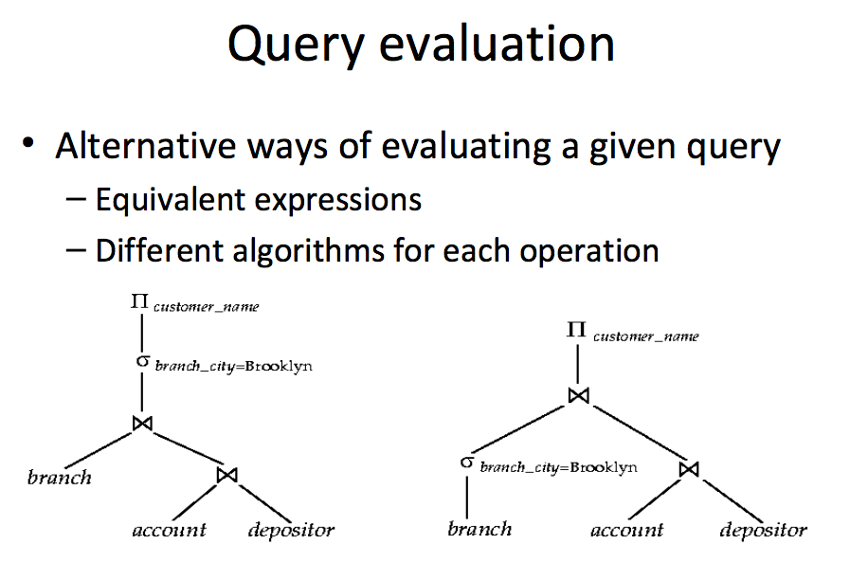
Many Ways to Evaluate a Query
Notes:
Most common query rewrite: push down a select into a branch (selection pushing)

Slide 33
Simple Technique – SELECTion Pushing
Consider two relations
StarsIn(title, year, star_name)
Movies(title, year, length, genre, studio_name, producer_no)
Find everyone who starred in a comedy movie in 1996
Query 1:
SELECT star_name, FROM StarsIn JOIN Movies ON StarsIn.title=Movies.title AND StarsIn.year=Movies.year WHERE StarsIn.year=1996 and Movies.genre=‘Comedy’
Query 2:
SELECT star_name FROM (SELECT star_name, title, year FROM StarsIn WHERE year=1996 as a) JOIN
(SELECT title, year, genre FROM Movies WHERE year=1996 AND genre=‘Comedy’) ON a.year=b.year and a.title=b.title
These queries are equivalent, but (2) is much more efficient.

Slide 34
Simple Technique – SELECTion Pushing
SELECT on a JOIN of table R and table S compares O(#(R)*#(S)) tuples
Have to load relevant blocks
Compare the tuples to compute the JOIN
Scan the JOIN to apply the SELECT
Pushing the SELECT(s) through the JOINs
May vastly reduce the size of the table to JOIN
Only JOIN tuples that could be selected in the WHERE clause.
You can also push project through JOIN, but this reduces the size of the data, not the number of tuples examined.
Consider two relations
StarsIn(title, year, star_name)
Movies(title, year, length, genre, studio_name, producer_no)
Find everyone who starred in a comedy movie in 1996
Query 1:
SELECT star_name, FROM StarsIn JOIN Movies ON StarsIn.title=Movies.title AND StarsIn.year=Movies.year WHERE StarsIn.year=1996 and Movies.genre=‘Comedy’
Query 2:
SELECT star_name FROM (SELECT star_name, title, year FROM StarsIn WHERE year=1996 as a) JOIN
(SELECT title, year, genre FROM Movies WHERE year=1996 AND genre=‘Comedy’) ON a.year=b.year and a.title=b.title
These queries are equivalent, but (2) is much more efficient.

Slide 35
A Note on Complex Selections
(day<8/9/94 AND rname=‘Paul’) OR bid=5 OR sid=3
Selection conditions are first converted to conjunctive normal form (CNF):
(day<8/9/94 OR bid=5 OR sid=3 ) AND (rname=‘Paul’ OR bid=5 OR sid=3)
We only discuss case with no ORs; see text if you are curious about the general case.
Notes:
13

Slide 36
One Approach to Selections
Find the most selective access path, retrieve tuples using it, and apply any remaining terms that don’t match the index:
Most selective access path: An index or file scan that we estimate will require the fewest page I/Os.
Terms that match this index reduce the number of tuples retrieved; other terms are used to discard some retrieved tuples, but do not affect number of tuples/pages fetched.
Consider day<8/9/94 AND bid=5 AND sid=3. A B+ tree index on day can be used; then, bid=5 and sid=3 must be checked for each retrieved tuple. Similarly, a hash index on <bid, sid> could be used; day<8/9/94 must then be checked.
Notes:
14

Slide 37
Using an Index for Selections
Cost depends on #qualifying tuples, and clustering.
Cost of finding qualifying data entries (typically small) plus cost of retrieving records (could be large w/o clustering).
In example, assuming uniform distribution of names, about 10% of tuples qualify (100 pages, 10000 tuples). With a clustered index, cost is little more than 100 I/Os; if unclustered, upto 10000 I/Os!
SELECT *
FROM Reserves R
WHERE R.rname < ‘C%’
Notes:
12

Slide 38
Projection
SELECT DISTINCT
R.sid, R.bid
FROM Reserves R
The expensive part is removing duplicates.
SQL systems don’t remove duplicates unless the keyword DISTINCT is specified in a query.
Sorting Approach: Sort on <sid, bid> and remove duplicates. (Can optimize this by dropping unwanted information while sorting.)
Hashing Approach: Hash on <sid, bid> to create partitions. Load partitions into memory one at a time, build in-memory hash structure, and eliminate duplicates.
If there is an index with both R.sid and R.bid in the search key, may be cheaper to sort data entries!
Notes:
16

Slide 39
Join: Index Nested Loops
Default:
foreach tuple r in R do
foreach tuple s in S where r_{i} == s_{j} do
add <r, s> to result
Cost: R*S
If there is an index on the join column of one relation (say S), can make it the inner and exploit the index.
Cost: M + ( (M*p_{R}) * cost of finding matching S tuples)
M=#pages of R, p_{R}=# R tuples per page
For each R tuple, cost of probing S index is about 1.2 for hash index, 2-4 for B+ tree. Cost of then finding S tuples (assuming Alt. (2) or (3) for data entries) depends on clustering.
Clustered index: 1 I/O (typical), unclustered: upto 1 I/O per matching S tuple.
Notes:
Most optimization comes from JOINS

Slide 40
Join: Sort-Merge (R S)
i=j
Sort R and S on the join column, then scan them to do a ``merge’’ (on join col.), and output result tuples.
Advance scan of R until current R-tuple >= current S tuple, then advance scan of S until current S-tuple >= current R tuple; do this until current R tuple = current S tuple.
At this point, all R tuples with same value in Ri (current R group) and all S tuples with same value in Sj (current S group) match; output <r, s> for all pairs of such tuples.
Then resume scanning R and S.
R is scanned once; each S group is scanned once per matching R tuple. (Multiple scans of an S group are likely to find needed pages in buffer.)
Notes:
11

Slide 41
Example of Sort-Merge Join
Cost: M log M + N log N + (M+N)
The cost of scanning, M+N, could be M*N (very unlikely!)
With 35, 100 or 300 buffer pages, both Reserves and Sailors can be sorted in 2 passes; total join cost: 7500.
Notes:
12

Slide 42
Query Processing and Optimization (Database Systems Concepts, V7, Ch. 15)
42 | Introduction to Databases (S20): Lecture 10: Indexes, Query Processing/Optimization

Slide 43
Basic Steps in Query Processing: Optimization
A relational algebra expression may have many equivalent expressions
E.g., σ_{salary<75000}(∏_{salary}(instructor)) is equivalent to ∏_{salary}(σ_{salary<75000}(instructor))
Each relational algebra operation can be evaluated using one of several different algorithms
Correspondingly, a relational-algebra expression can be evaluated in many ways.
Annotated expression specifying detailed evaluation strategy is called an evaluation-plan. E.g.,:
Use an index on salary to find instructors with salary < 75000,
Or perform complete relation scan and discard instructors with salary ≥ 75000

Slide 44
Basic Steps: Optimization (Cont.)
Query Optimization: Amongst all equivalent evaluation plans choose the one with lowest cost.
Cost is estimated using statistical information from the database catalog
e.g.. number of tuples in each relation, size of tuples, etc.
In this chapter we study
How to measure query costs
Algorithms for evaluating relational algebra operations
How to combine algorithms for individual operations in order to evaluate a complete expression
In Chapter 16
We study how to optimize queries, that is, how to find an evaluation plan with lowest estimated cost

Slide 45
Measures of Query Cost
Many factors contribute to time cost
disk access, CPU, and network communication
Cost can be measured based on
response time, i.e. total elapsed time for answering query, or
total resource consumption
We use total resource consumption as cost metric
Response time harder to estimate, and minimizing resource consumption is a good idea in a shared database
We ignore CPU costs for simplicity
Real systems do take CPU cost into account
Network costs must be considered for parallel systems
We describe how estimate the cost of each operation
We do not include cost to writing output to disk

Slide 46
Measures of Query Cost
Disk cost can be estimated as:
Number of seeks * average-seek-cost
Number of blocks read * average-block-read-cost
Number of blocks written * average-block-write-cost
For simplicity we just use the number of block transfers from disk and the number of seeks as the cost measures
t_{T} – time to transfer one block
Assuming for simplicity that write cost is same as read cost
t_{S} – time for one seek
Cost for b block transfers plus S seeks b * t_{T} + S * t_{S}
t_{S} and t_{T} depend on where data is stored; with 4 KB blocks:
High end magnetic disk: t_{S} = 4 msec and t_{T} =0.1 msec
SSD: t_{S} = 20-90 microsec and t_{T} = 2-10 microsec for 4KB

Slide 47
Measures of Query Cost (Cont.)
Required data may be buffer resident already, avoiding disk I/O
But hard to take into account for cost estimation
Several algorithms can reduce disk IO by using extra buffer space
Amount of real memory available to buffer depends on other concurrent queries and OS processes, known only during execution
Worst case estimates assume that no data is initially in buffer and only the minimum amount of memory needed for the operation is available
But more optimistic estimates are used in practice
Notes:
47

Slide 48
Selection Operation
File scan
Algorithm A1 (linear search). Scan each file block and test all records to see whether they satisfy the selection condition.
Cost estimate = b_{r} block transfers + 1 seek
b_{r} denotes number of blocks containing records from relation r
If selection is on a key attribute, can stop on finding record
cost = (b_{r} /2) block transfers + 1 seek
Linear search can be applied regardless of
selection condition or
ordering of records in the file, or
availability of indices
Note: binary search generally does not make sense since data is not stored consecutively
except when there is an index available,
and binary search requires more seeks than index search

Slide 49
Selections Using Indices
Index scan – search algorithms that use an index
selection condition must be on search-key of index.
A2 (clustering index, equality on key). Retrieve a single record that satisfies the corresponding equality condition
Cost = (h_{i} + 1) * (t_{T} + t_{S})
A3 (clustering index, equality on nonkey) Retrieve multiple records.
Records will be on consecutive blocks
Let b = number of blocks containing matching records
Cost = h_{i} * (t_{T} + t_{S}) + t_{S} + t_{T} * b

Slide 50
Selections Using Indices
A4 (secondary index, equality on key/non-key).
Retrieve a single record if the search-key is a candidate key
Cost = (h_{i} + 1) * (t_{T} + t_{S})
Retrieve multiple records if search-key is not a candidate key
each of n matching records may be on a different block
Cost = (h_{i} + n) * (t_{T} + t_{S})
Can be very expensive!
Notes:
50

Slide 51
Selections Involving Comparisons
Can implement selections of the form σ_{A≤V} (r) or σ_{A ≥ V}(r) by using
a linear file scan,
or by using indices in the following ways:
A5 (clustering index, comparison). (Relation is sorted on A)
For σ_{A ≥ V}(r) use index to find first tuple ≥ v and scan relation sequentially from there
For σ_{A≤V} (r) just scan relation sequentially till first tuple > v; do not use index
A6 (clustering index, comparison).
For σ_{A ≥ V}(r) use index to find first index entry ≥ v and scan index sequentially from there, to find pointers to records.
For σ_{A≤V} (r) just scan leaf pages of index finding pointers to records, till first entry > v
In either case, retrieve records that are pointed to
requires an I/O per record; Linear file scan may be cheaper!

Slide 52
Implementation of Complex Selections
Conjunction: σ_{θ1}∧ _{θ2}∧. . . _{θn}(r)
A7 (conjunctive selection using one index).
Select a combination of θ_{i} and algorithms A1 through A7 that results in the least cost for σ_{θi} (r).
Test other conditions on tuple after fetching it into memory buffer.
A8 (conjunctive selection using composite index).
Use appropriate composite (multiple-key) index if available.
A9 (conjunctive selection by intersection of identifiers).
Requires indices with record pointers.
Use corresponding index for each condition, and take intersection of all the obtained sets of record pointers.
Then fetch records from file
If some conditions do not have appropriate indices, apply test in memory.

Slide 53
Algorithms for Complex Selections
Disjunction:σ_{θ1}∨ _{θ2} ∨. . . _{θn} (r).
A10 (disjunctive selection by union of identifiers).
Applicable if all conditions have available indices.
Otherwise use linear scan.
Use corresponding index for each condition, and take union of all the obtained sets of record pointers.
Then fetch records from file
Negation: σ_{¬θ}(r)
Use linear scan on file
If very few records satisfy ¬θ, and an index is applicable to θ
Find satisfying records using index and fetch from file

Slide 54
Bitmap Index Scan
The bitmap index scan algorithm of PostgreSQL
Bridges gap between secondary index scan and linear file scan when number of matching records is not known before execution
Bitmap with 1 bit per page in relation
Steps:
Index scan used to find record ids, and set bit of corresponding page in bitmap
Linear file scan fetching only pages with bit set to 1
Performance
Similar to index scan when only a few bits are set
Similar to linear file scan when most bits are set
Never behaves very badly compared to best alternative

Slide 55
Sorting
We may build an index on the relation, and then use the index to read the relation in sorted order. May lead to one disk block access for each tuple.
For relations that fit in memory, techniques like quicksort can be used.
For relations that don’t fit in memory, external sort-merge is a good choice.

Slide 56
Example: External Sorting Using Sort-Merge

Slide 57
External Sort-Merge
Let M denote memory size (in pages).
1. Create sorted runs. Let i be 0 initially. Repeatedly do the following till the end of the relation: (a) Read M blocks of relation into memory (b) Sort the in-memory blocks (c) Write sorted data to run R_{i}; increment i.
Let the final value of i be N
2. Merge the runs (next slide)…..

Slide 58
External Sort-Merge (Cont.)
2. Merge the runs (N-way merge). We assume (for now) that N < M.
1. Use N blocks of memory to buffer input runs, and 1 block to buffer output. Read the first block of each run into its buffer page
2. repeat
Select the first record (in sort order) among all buffer pages
Write the record to the output buffer. If the output buffer is full write it to disk.
Delete the record from its input buffer page. If the buffer page becomes empty then read the next block (if any) of the run into the buffer.
3. until all input buffer pages are empty:

Slide 59
External Sort-Merge (Cont.)
If N ≥ M, several merge passes are required.
In each pass, contiguous groups of M - 1 runs are merged.
A pass reduces the number of runs by a factor of M -1, and creates runs longer by the same factor.
E.g. If M=11, and there are 90 runs, one pass reduces the number of runs to 9, each 10 times the size of the initial runs
Repeated passes are performed till all runs have been merged into one.

Slide 60
External Merge Sort (Cont.)
Cost analysis:
1 block per run leads to too many seeks during merge
Instead use b_{b} buffer blocks per run
➔ read/write b_{b} blocks at a time
Can merge ⎣M/b_{b}⎦–1 runs in one pass
Total number of merge passes required: ⎡log _{⎣M/bb⎦–1}(b_{r}/M)⎤.
Block transfers for initial run creation as well as in each pass is 2b_{r}
for final pass, we don’t count write cost
we ignore final write cost for all operations since the output of an operation may be sent to the parent operation without being written to disk
Thus total number of block transfers for external sorting: b_{r} ( 2 ⎡log _{⎣M/bb⎦–1} (b_{r} / M)⎤ + 1) ⎡
Seeks: next slide

Slide 61
External Merge Sort (Cont.)
Cost of seeks
During run generation: one seek to read each run and one seek to write each run
2 ⎡b_{r} / M⎤
During the merge phase
Need 2 ⎡b_{r} / b_{b}⎤ seeks for each merge pass
except the final one which does not require a write
Total number of seeks: 2 ⎡b_{r} / M⎤ + ⎡b_{r} / b_{b}⎤ (2 ⎡log_{⎣M/bb⎦–1}(b_{r} / M)⎤ -1)

Slide 62
Join Operation
Several different algorithms to implement joins
Nested-loop join
Block nested-loop join
Indexed nested-loop join
Merge-join
Hash-join
Choice based on cost estimate
Examples use the following information
Number of records of student: 5,000 takes: 10,000
Number of blocks of student: 100 takes: 400

Slide 63
Nested-Loop Join
To compute the theta join r ⨝ _{θ} s for each tuple t_{r} in r do begin for each tuple t_{s} in s do begin test pair (t_{r},t_{s}) to see if they satisfy the join condition θ if they do, add t_{r} • t_{s} to the result. end end
r is called the outer relation and s the inner relation of the join.
Requires no indices and can be used with any kind of join condition.
Expensive since it examines every pair of tuples in the two relations.
Notes:
Default JOIN

Slide 64
Nested-Loop Join (Cont.)
In the worst case, if there is enough memory only to hold one block of each relation, the estimated cost is n_{r} ∗ b_{s} + b_{r} block transfers, plus n_{r} + b_{r} seeks
If the smaller relation fits entirely in memory, use that as the inner relation.
Reduces cost to b_{r} + b_{s} block transfers and 2 seeks
Assuming worst case memory availability cost estimate is
with student as outer relation:
5000 ∗ 400 + 100 = 2,000,100 block transfers,
5000 + 100 = 5100 seeks
with takes as the outer relation
10000 ∗ 100 + 400 = 1,000,400 block transfers and 10,400 seeks
If smaller relation (student) fits entirely in memory, the cost estimate will be 500 block transfers.
Block nested-loops algorithm (next slide) is preferable.

Slide 65
Block Nested-Loop Join
Variant of nested-loop join in which every block of inner relation is paired with every block of outer relation.
for each block B_{r} of r do begin for each block B_{s} of s do begin for each tuple t_{r} in B_{r} do begin for each tuple t_{s} in B_{s} do begin Check if (t_{r},t_{s}) satisfy the join condition if they do, add t_{r} • t_{s} to the result. end end end end

Slide 66
Block Nested-Loop Join (Cont.)
Worst case estimate: b_{r} ∗ b_{s} + b_{r} block transfers + 2 * b_{r} seeks
Each block in the inner relation s is read once for each block in the outer relation
Best case: b_{r} + b_{s} block transfers + 2 seeks.
Improvements to nested loop and block nested loop algorithms:
In block nested-loop, use M — 2 disk blocks as blocking unit for outer relations, where M = memory size in blocks; use remaining two blocks to buffer inner relation and output
Cost = ⎡b_{r} / (M-2)⎤ ∗ b_{s} + b_{r} block transfers + 2 ⎡b_{r} / (M-2)⎤ seeks
If equi-join attribute forms a key or inner relation, stop inner loop on first match
Scan inner loop forward and backward alternately, to make use of the blocks remaining in buffer (with LRU replacement)
Use index on inner relation if available (next slide)

Slide 67
Indexed Nested-Loop Join
Index lookups can replace file scans if
join is an equi-join or natural join and
an index is available on the inner relation’s join attribute
Can construct an index just to compute a join.
For each tuple t_{r} in the outer relation r, use the index to look up tuples in s that satisfy the join condition with tuple t_{r}.
Worst case: buffer has space for only one page of r, and, for each tuple in r, we perform an index lookup on s.
Cost of the join: b_{r} (t_{T} + t_{S}) + n_{r} ∗ c
Where c is the cost of traversing index and fetching all matching s tuples for one tuple or r
c can be estimated as cost of a single selection on s using the join condition.
If indices are available on join attributes of both r and s, use the relation with fewer tuples as the outer relation.
Notes:
Build index on non-indexed table
Cost of building a sorted index: n*log(n)
IF only have equality operator:
Can build a hash index in order n

Slide 68
Example of Nested-Loop Join Costs
Compute student ⨝ takes, with student as the outer relation.
Let takes have a primary B⁺-tree index on the attribute ID, which contains 20 entries in each index node.
Since takes has 10,000 tuples, the height of the tree is 4, and one more access is needed to find the actual data
student has 5000 tuples
Cost of block nested loops join
400*100 + 100 = 40,100 block transfers + 2 * 100 = 200 seeks
assuming worst case memory
may be significantly less with more memory
Cost of indexed nested loops join
100 + 5000 * 5 = 25,100 block transfers and seeks.
CPU cost likely to be less than that for block nested loops join

Slide 69
Merge-Join
1. Sort both relations on their join attribute (if not already sorted on the join
attributes).
2. Merge the sorted relations to join them
1. Join step is similar to the merge stage of the sort-merge algorithm.
2. Main difference is handling of duplicate values in join attribute —
every pair with same value on join attribute must be matched
3. Detailed algorithm in book

Slide 70
Merge-Join (Cont.)
Can be used only for equi-joins and natural joins
Each block needs to be read only once (assuming all tuples for any given value of the join attributes fit in memory
Thus the cost of merge join is: b_{r} + b_{s} block transfers + ⎡b_{r} / b_{b}⎤ + ⎡b_{s} / b_{b}⎤ seeks
+ the cost of sorting if relations are unsorted.
hybrid merge-join: If one relation is sorted, and the other has a secondary B⁺-tree index on the join attribute
Merge the sorted relation with the leaf entries of the B⁺-tree .
Sort the result on the addresses of the unsorted relation’s tuples
Scan the unsorted relation in physical address order and merge with previous result, to replace addresses by the actual tuples
Sequential scan more efficient than random lookup

Slide 71
Hash-Join
Applicable for equi-joins and natural joins.
A hash function h is used to partition tuples of both relations
h maps JoinAttrs values to {0, 1, ..., n}, where JoinAttrs denotes the common attributes of r and s used in the natural join.
r₀, r₁, . . ., r_{n} denote partitions of r tuples
Each tuple t_{r} ∈ r is put in partition r_{i} where i = h(t_{r} [JoinAttrs]).
r₀,, r₁. . ., r_{n} denotes partitions of s tuples
Each tuple t_{s} ∈s is put in partition s_{i}, where i = h(t_{s} [JoinAttrs]).
Note: In book, Figure 12.10 r_{i} is denoted as H_{ri,} s_{i} is denoted as H_{si} and n is denoted as n_{h.}

Slide 72
Hash-Join (Cont.)

Slide 73
Hash-Join (Cont.)
r tuples in r_{i} need only to be compared with s tuples in s_{i} Need not be compared with s tuples in any other partition, since:
an r tuple and an s tuple that satisfy the join condition will have the same value for the join attributes.
If that value is hashed to some value i, the r tuple has to be in r_{i} and the s tuple in s_{i}.

Slide 74
Hash-Join Algorithm
The hash-join of r and s is computed as follows.
1. Partition the relation s using hashing function h. When partitioning a relation, one block of memory is reserved as the output buffer for each partition.
2. Partition r similarly.
3. For each i:
(a) Load s_{i} into memory and build an in-memory hash index on it using the join attribute. This hash index uses a different hash function than the earlier one h.
(b) Read the tuples in r_{i} from the disk one by one. For each tuple t_{r} locate each matching tuple t_{s} in s_{i} using the in-memory hash index. Output the concatenation of their attributes.
Relation s is called the build input and r is called the probe input.

Slide 75
Hash-Join algorithm (Cont.)
The value n and the hash function h is chosen such that each s_{i} should fit in memory.
Typically n is chosen as ⎡b_{s}/M⎤ * f where f is a “fudge factor”, typically around 1.2
The probe relation partitions s_{i} need not fit in memory
Recursive partitioning required if number of partitions n is greater than number of pages M of memory.
instead of partitioning n ways, use M – 1 partitions for s
Further partition the M – 1 partitions using a different hash function
Use same partitioning method on r
Rarely required: e.g., with block size of 4 KB, recursive partitioning not needed for relations of < 1GB with memory size of 2MB, or relations of < 36 GB with memory of 12 MB

Slide 76
Handling of Overflows
Partitioning is said to be skewed if some partitions have significantly more tuples than some others
Hash-table overflow occurs in partition s_{i} if s_{i} does not fit in memory. Reasons could be
Many tuples in s with same value for join attributes
Bad hash function
Overflow resolution can be done in build phase
Partition s_{i} is further partitioned using different hash function.
Partition r_{i} must be similarly partitioned.
Overflow avoidance performs partitioning carefully to avoid overflows during build phase
E.g., partition build relation into many partitions, then combine them
Both approaches fail with large numbers of duplicates
Fallback option: use block nested loops join on overflowed partitions

Slide 77
Cost of Hash-Join
If recursive partitioning is not required: cost of hash join is 3(b_{r} + b_{s}) +4 ∗ n_{h} block transfers + 2( ⎡b_{r} / b_{b}⎤ + ⎡b_{s} / b_{b}⎤) seeks
If recursive partitioning required:
number of passes required for partitioning build relation s to less than M blocks per partition is ⎡log_{⎣M/bb⎦–1}(b_{s}/M)⎤
best to choose the smaller relation as the build relation.
Total cost estimate is: 2(b_{r} + b_{s}) ⎡log_{⎣M/bb⎦–1}(b_{s}/M)⎤ + b_{r} + b_{s} block transfers + 2(⎡b_{r} / b_{b}⎤ + ⎡b_{s} / b_{b}⎤) ⎡log_{⎣M/bb⎦–1}(b_{s}/M) ⎤ seeks
If the entire build input can be kept in main memory no partitioning is required
Cost estimate goes down to b_{r} + b_{s}.

Slide 78
Example of Cost of Hash-Join
instructor ⨝ teaches
Assume that memory size is 20 blocks
b_{instructor}= 100 and b_{teaches} = 400.
instructor is to be used as build input. Partition it into five partitions, each of size 20 blocks. This partitioning can be done in one pass.
Similarly, partition teaches into five partitions,each of size 80. This is also done in one pass.
Therefore total cost, ignoring cost of writing partially filled blocks:
3(100 + 400) = 1500 block transfers + 2( ⎡100/3⎤ + ⎡400/3⎤) = 336 seeks

Slide 79
Hybrid Hash–Join
Useful when memory sized are relatively large, and the build input is bigger than memory.
Main feature of hybrid hash join:
Keep the first partition of the build relation in memory.
E.g. With memory size of 25 blocks, instructor can be partitioned into five partitions, each of size 20 blocks.
Division of memory:
The first partition occupies 20 blocks of memory
1 block is used for input, and 1 block each for buffering the other 4 partitions.
teaches is similarly partitioned into five partitions each of size 80
the first is used right away for probing, instead of being written out
Cost of 3(80 + 320) + 20 +80 = 1300 block transfers for hybrid hash join, instead of 1500 with plain hash-join.
Hybrid hash-join most useful if M >>

Slide 80
Complex Joins
Join with a conjunctive condition:
r ⨝ _{θ1∧ θ 2∧... ∧ θ n} s
Either use nested loops/block nested loops, or
Compute the result of one of the simpler joins r ⨝ _{θi} s
final result comprises those tuples in the intermediate result that satisfy the remaining conditions
θ₁ ∧ . . . ∧ θ_{i –1} ∧ θ_{i +1} ∧ . . . ∧ θ_{n}
Join with a disjunctive condition
r ⨝ _{θ1 ∨ θ2 ∨... ∨ θn} s
Either use nested loops/block nested loops, or
Compute as the union of the records in individual joins r ⨝ _{θi} s:
(r ⨝ _{θ1} s) ∪ (r ⨝ _{θ2} s) ∪ . . . ∪ (r ⨝ _{θn} s)

Slide 81
Other Operations
Duplicate elimination can be implemented via hashing or sorting.
On sorting duplicates will come adjacent to each other, and all but one set of duplicates can be deleted.
Optimization: duplicates can be deleted during run generation as well as at intermediate merge steps in external sort-merge.
Hashing is similar – duplicates will come into the same bucket.
Projection:
perform projection on each tuple
followed by duplicate elimination.

Slide 82
Other Operations : Aggregation
Aggregation can be implemented in a manner similar to duplicate elimination.
Sorting or hashing can be used to bring tuples in the same group together, and then the aggregate functions can be applied on each group.
Optimization: partial aggregation
combine tuples in the same group during run generation and intermediate merges, by computing partial aggregate values
For count, min, max, sum: keep aggregate values on tuples found so far in the group.
When combining partial aggregate for count, add up the partial aggregates
For avg, keep sum and count, and divide sum by count at the end

Slide 83
Evaluation of Expressions
So far: we have seen algorithms for individual operations
Alternatives for evaluating an entire expression tree
Materialization: generate results of an expression whose inputs are relations or are already computed, materialize (store) it on disk. Repeat.
Pipelining: pass on tuples to parent operations even as an operation is being executed
We study above alternatives in more detail

Slide 84
Materialization
Materialized evaluation: evaluate one operation at a time, starting at the lowest-level. Use intermediate results materialized into temporary relations to evaluate next-level operations.
E.g., in figure below, compute and store then compute the store its join with instructor, and finally compute the projection on name.
Notes:
Materialization: run first operation completely, then load table for next operation
Stream/pipelining: every time select runs and returns a tuple, do JOIN on tuple

Slide 85
Materialization (Cont.)
Materialized evaluation is always applicable
Cost of writing results to disk and reading them back can be quite high
Our cost formulas for operations ignore cost of writing results to disk, so
Overall cost = Sum of costs of individual operations + cost of writing intermediate results to disk
Double buffering: use two output buffers for each operation, when one is full write it to disk while the other is getting filled
Allows overlap of disk writes with computation and reduces execution time

Slide 86
Pipelining
Pipelined evaluation: evaluate several operations simultaneously, passing the results of one operation on to the next.
E.g., in previous expression tree, don’t store result of
instead, pass tuples directly to the join.. Similarly, don’t store result of join, pass tuples directly to projection.
Much cheaper than materialization: no need to store a temporary relation to disk.
Pipelining may not always be possible – e.g., sort, hash-join.
For pipelining to be effective, use evaluation algorithms that generate output tuples even as tuples are received for inputs to the operation.
Pipelines can be executed in two ways: demand driven and producer driven

Slide 87
Pipelining (Cont.)
In demand driven or lazy evaluation
system repeatedly requests next tuple from top level operation
Each operation requests next tuple from children operations as required, in order to output its next tuple
In between calls, operation has to maintain “state” so it knows what to return next
In producer-driven or eager pipelining
Operators produce tuples eagerly and pass them up to their parents
Buffer maintained between operators, child puts tuples in buffer, parent removes tuples from buffer
if buffer is full, child waits till there is space in the buffer, and then generates more tuples
System schedules operations that have space in output buffer and can process more input tuples
Alternative name: pull and push models of pipelining

Slide 88
Pipelining (Cont.)
Implementation of demand-driven pipelining
Each operation is implemented as an iterator implementing the following operations
open()
E.g., file scan: initialize file scan
state: pointer to beginning of file
E.g., merge join: sort relations;
state: pointers to beginning of sorted relations
next()
E.g., for file scan: Output next tuple, and advance and store file pointer
E.g., for merge join: continue with merge from earlier state till next output tuple is found. Save pointers as iterator state.
close()

Slide 89
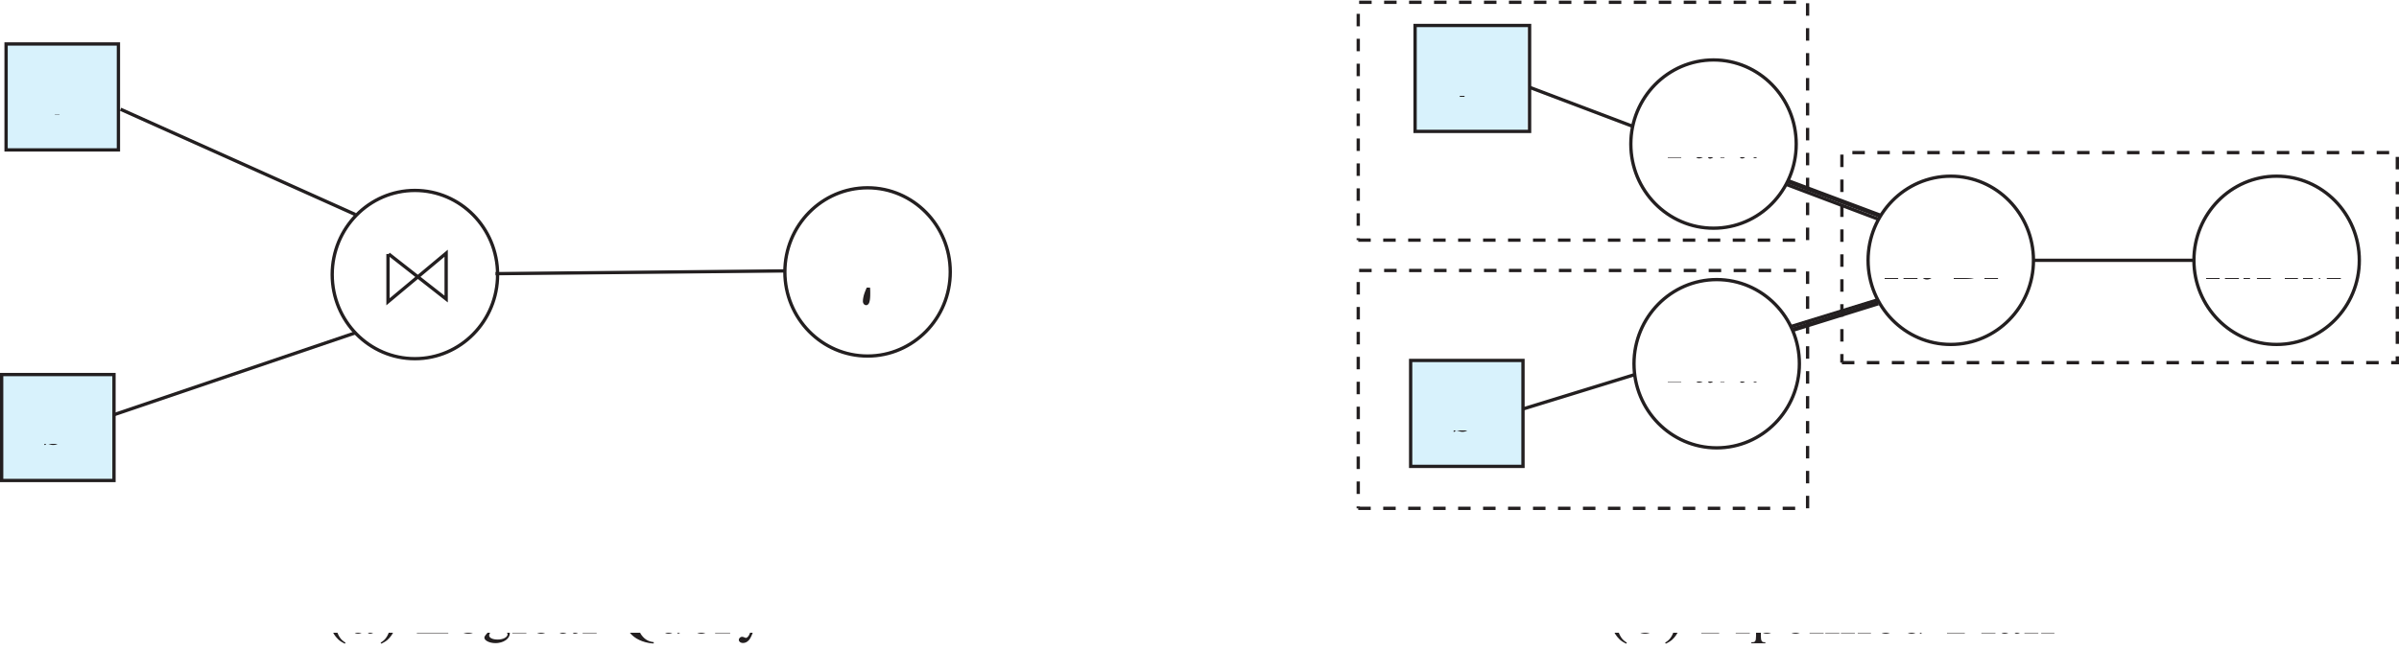
Blocking Operations
Blocking operations: cannot generate any output until all input is consumed
E.g., sorting, aggregation, …
But can often consume inputs from a pipeline, or produce outputs to a pipeline
Key idea: blocking operations often have two suboperations
E.g., for sort: run generation and merge
For hash join: partitioning and build-probe
Treat them as separate operations

Slide 90
Pipeline Stages
Pipeline stages:
All operations in a stage run concurrently
A stage can start only after preceding stages have completed execution

Slide 91
Evaluation Algorithms for Pipelining
Some algorithms are not able to output results even as they get input tuples
E.g., merge join, or hash join
intermediate results written to disk and then read back
Algorithm variants to generate (at least some) results on the fly, as input tuples are read in
E.g., hybrid hash join generates output tuples even as probe relation tuples in the in-memory partition (partition 0) are read in
Double-pipelined join technique: Hybrid hash join, modified to buffer partition 0 tuples of both relations in-memory, reading them as they become available, and output results of any matches between partition 0 tuples
When a new r₀ tuple is found, match it with existing s₀ tuples, output matches, and save it in r₀
Symmetrically for s₀ tuples

Slide 92
Pipelining for Continuous-Stream Data
Data streams
Data entering database in a continuous manner
E.g., Sensor networks, user clicks, …
Continuous queries
Results get updated as streaming data enters the database
Aggregation on windows is often used
E.g., tumbling windows divide time into units, e.g., hours, minutes
Need to use pipelined processing algorithms
Punctuations used to infer when all data for a window has been received

Slide 93
Cache Conscious Algorithms
Goal: minimize cache misses, make best use of data fetched into the cache as part of a cache line
For sorting:
Use runs that are as large as L3 cache (a few megabytes) to avoid cache misses during sorting of a run
Then merge runs as usual in merge-sort
For hash-join
First create partitions such that build+probe partitions fit in memory
Then subpartition further s.t. build subpartition+index fits in L3 cache
Speeds up probe phase significantly by avoiding cache misses
Lay out attributes of tuples to maximize cache usage
Attributes that are often accessed together should be stored adjacent to each other
Use multiple threads for parallel query processing
Cache misses leads to stall of one thread, but others can proceed

Slide 94
End of Chapter 15
Notes:
Note: chapter 16 is ALSO query optimization
There are A LOT of optimization methods out there

Slide 95
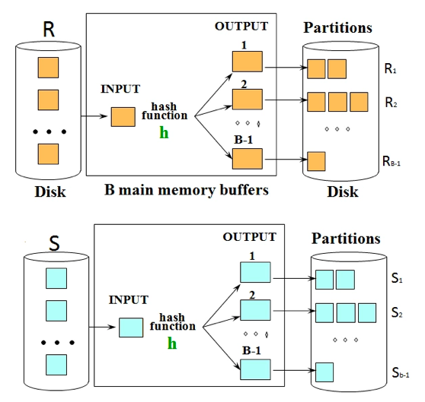
Hash JOIN (http://cs186.wikia.com/wiki/Joins)
Hash join uses two stages to accomplish the join.
The initial partitioning phase,
Followed by the probing phase.
In the first stage, we hash the two relations into partitions on disk using a hash function that partitions based on the join condition. The relation R gets partitioned into Ri and the relation S gets partitioned into Si. The diagram on the right demonstrates the first stage of the hash join. We will see that in the second stage, we will match Ri to Si partitions.

Slide 96
Hash JOIN (http://cs186.wikia.com/wiki/Joins)
In the second stage,
We use an in-memory hash table to perform the joining.
Read in partition Ri and hash it into the in memory hash table
Scan partition Si and probe the in memory hash table for matches.
Matches go to the output buffer

